Slide 1
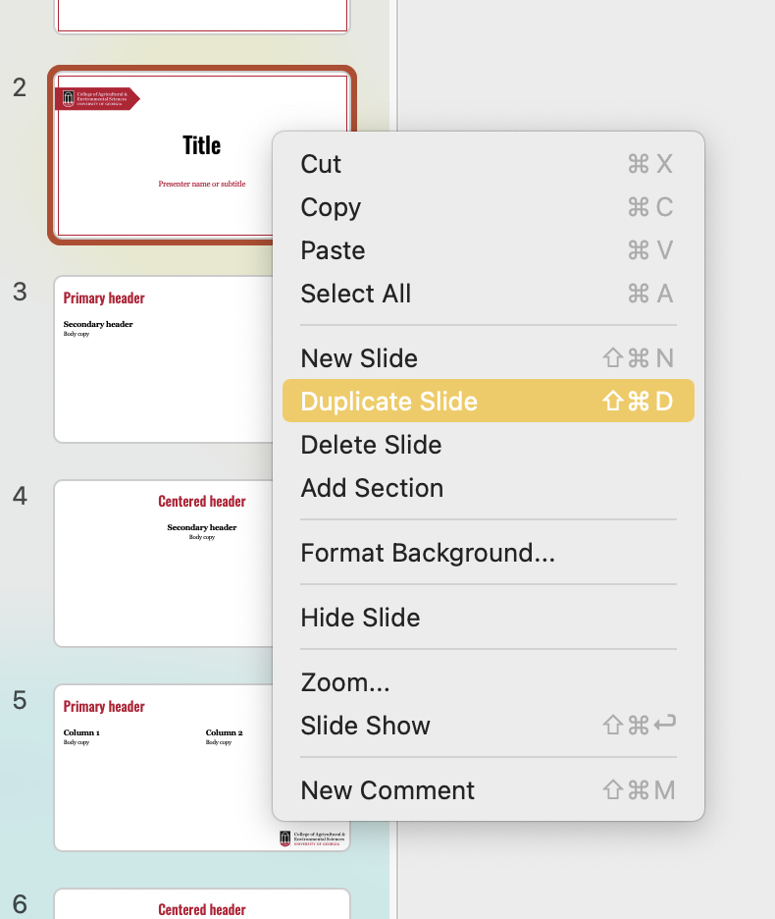
Please delete this slide before using this template.
When creating new slides, we recommend using the “Duplicate Slide” function.
Choose the slide you wish to use, right-click and select "Duplicate Slide.” This method preserves the layout, font and color selections of the template.
If you have any issues using this template, please reach out to caesomc@uga.edu.

Slide 2


Bartow Master Gardeners:
Workshop Title
Your Name
Bartow County Master Gardener
Extension Volunteer
Extension.uga.edu/bartow

Slide 4
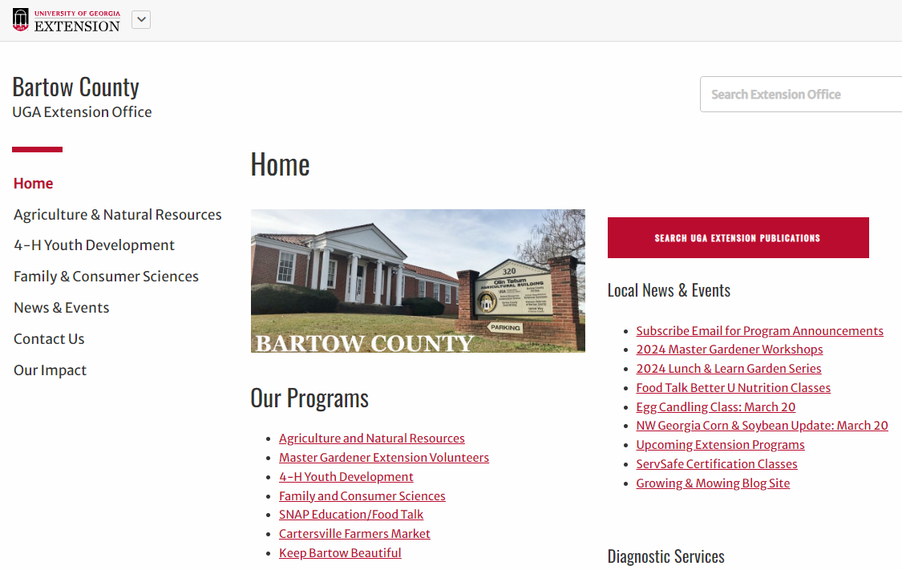
Please Return Seminar Evaluations.
Questions?
Call 1-800-ASK-UGA1
Go to Extension.uga.edu/bartow
  Click on “Search UGA Extension Publications” link at top of webpage:

Slide 5
