Slide 1
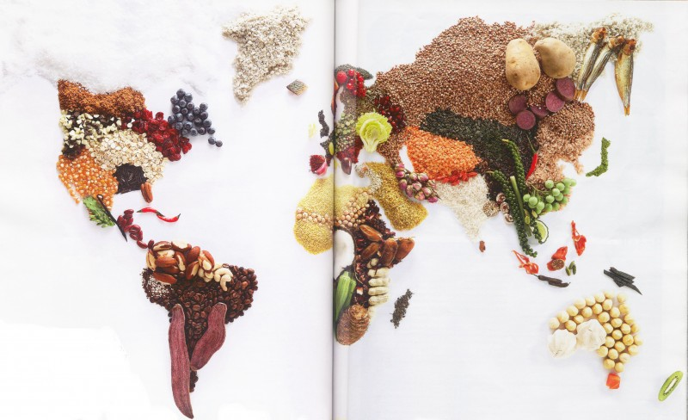
FARMERS MARKETS AROUND THE WORLD

Slide 2
Bangkok, Thailand (Asia)

Slide 3
Udaipur, India (Asia)

Slide 4
Benin (Africa)

Slide 5
Bologna, Italy (Europe)

Slide 6
La Paz, Bolivia (South America)

Slide 7
Xela, Guatemala (Central America)

Slide 8
California, United States (North America)

Slide 9
Athens, Georgia!

