Slide 1
Tree Quiz

Slide 2
The Pines

Slide 3
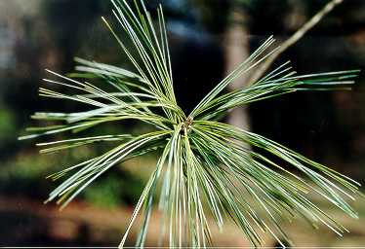

Slide 4
eastern white pine
5 needles per bundle, 1-5 inches long, 5 letters in “white”

Slide 6
loblolly pine
3 needles per bundle

Slide 8
longleaf pine
3 needles per bundle, very long

Slide 10
shortleaf pine
2 and 3 needles per bundle

Slide 12
slash pine
2 and 3 needles per bundle

Slide 14
Virginia pine
2 needles per bundle, twisted V for Virginia

Slide 15
Oaks

Slide 17
black oak
Tough leaves, pointed lobes

Slide 19
chestnut oak
Shallow rounded lobes

Slide 21
live oak
state tree, leathery leaf, sometimes curled under, evergreen oak

Slide 23
post oak
shaped like a cross, cross made from post

Slide 25
southern red oak
bell shaped at bottom, turned up, shaped like dress of “southern belle”

Slide 27
water oak
boat paddle/ water drop/ duck’s foot

Slide 29
white oak
Rounded, deeper lobes

Slide 30
Compound Leaves

Slide 32
black walnut
Compound leaves 12 to 12 inches long with 10-24 leaflets,

Slide 34
pecan
compound leaf, sickle shaped (curved leaf –smile)

Slide 36
mockernut hickory
compound leaf, fuzzy petiole, leaves

Slide 38
pignut hickory
compound leaf, smooth stem, hickory nut with ‘’pig snout”

Slide 40
black locust
Compound leaf, floppy

Slide 41
Maple family

Slide 43
red maple
often has red petiole (stem), 3 lobes

Slide 45
silver maple
silvery back, deeper lobes than red maple

Slide 47
boxelder
compound leaf with 3 to 5 leaflets, reminds of poison ivy

Slide 48
Needles/Scales not Pines

Slide 50
baldcypress
feather like leaves (Bald Eagle)

Slide 52
eastern hemlock
needles locked into place like stitches in hem, tiny cones

Slide 54
eastern redcedar
scales

Slide 55
Black cherry/ persimmon/ black gum

Slide 57
black cherry
serrated leaves, often fuzzy red along midvein

Slide 59
common persimmon
Black buds, may have fruit, often spotted later in year

Slide 61
black gum
Leaves come out in whorl

Slide 62
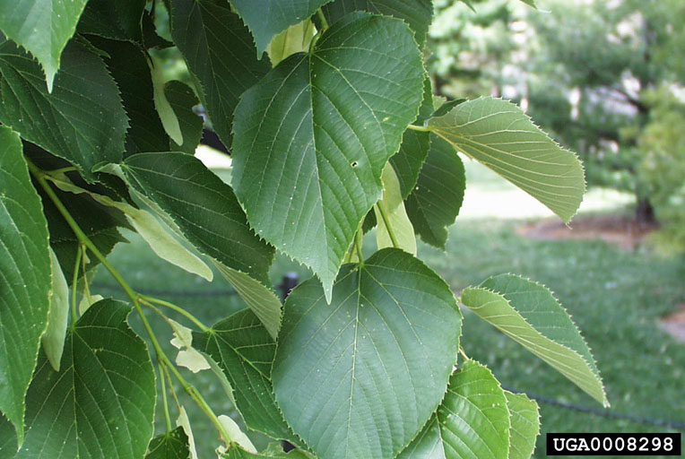

Slide 63
American basswood
Lopsided base

Slide 64
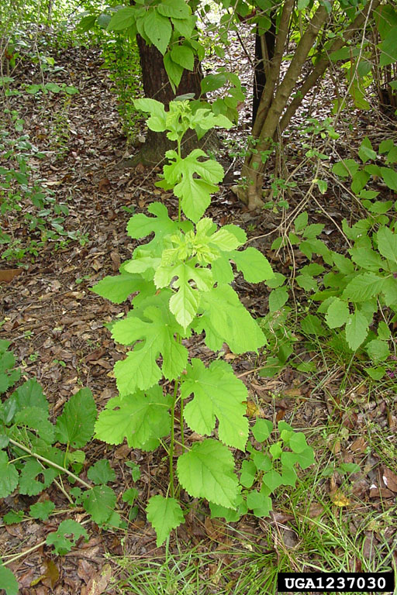

Slide 65
red mulberry
rough, larger, 3 leaf shapes, entire, mitten and ghost/dinosaur

Slide 67
sassafras
smooth smaller than mulberry,3 leaf shapes, entire, mitten, dinosaur/ghost

Slide 69
catalpa
big arrow shaped leaf, leaves opposite or whorled

Slide 71
eastern redbud
Heart shaped

Slide 73
eastern cottonwood
flattened petiole (stem) , triangular shape like a cotton boll

Slide 75
American elm
serrated, lopsided base

Slide 77
river birch
doubly serrate like waves on river, also angle base reminds of arrowhead

Slide 79
American beech
Long buds, fuzzy leaf, stem seems to ‘zig-zag’, tooth at end of each vein

Slide 81
black willow
long serrated leaf, “collar” at base of leaf

Slide 83
buckeye
palmately compound, reminds of “eye” lashes

Slide 85
American holly
prickly, Christmas decorations

Slide 87
flowering dogwood
Deep veins like bulldog, opposite leaves

Slide 89
southern magnolia
Tough leaves, dark green

Slide 91
Sweetgum
Star shaped, s-w-e-e-t = five points

Slide 93
sycamore
Sick cat

Slide 95
yellow-poplar
Cat’s head like Garfield the ‘popular/poplar’ yellow cat

